Slide 1
NUTRITION ASSISTANT APPLICATION
CLOUD APP DEVELOPMENT

Slide 2
TEAM MEMBERS
Team ID : PNT2022TMID41514
K.MEERA 621119104011
P.NIRMALA 6211191040012
D.DEEPA 621119104005
M.PRIYADHARSHINI 621119104013
IDHAYA ENGINEERING COLLEGE FOR WOMEN

Slide 3
OBJECTIVE
Due to the ignorance of healthy food habits, obesity rates are increasing high speed, and this is reflective of the risks to people’s health. People need to control their daily calorie take by eating healthy foods, which is the most basic method to avoid obesity. However, although food packaging comes with nutrition (and calorie) labels, it’s still not very convenient for people to refer to App-based nutrient dashboard systems which can analyze real-time images of a meal and analyze it for nutritional content which can be very handy and improves the dietary habits, and therefore, helps in maintaining a healthy lifestyle

Slide 4
AIM OF THIS PROJECT
This project aims is to build a web App that automatically estimates food attributes such as ingredients and nutritional value by classifying the input image of food. Our method employs clarification .And it is a user friendly.

Slide 5
WORK FLOW
User interacts with the Web App to Load an image.
The image is passed to the server application, which uses Clarifai's AI-Driven Food Detection Model Service to analyze the images and Nutrition API to provide nutritional information about the analyzed Image.
Nutritional information of the analyzed image is returned to the app for display.

Slide 6
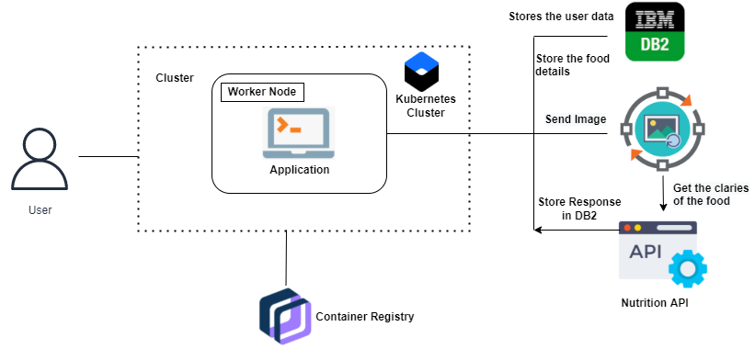
TECHNICAL ARCHITECTUR

Slide 7
BENEFITS OF THIS APP:
This app guide its users towards a healthy diet and assist them to achieve their health goals.
● Preventive nutrition services for this population, which include early identification and treatment, can help alleviate malnutrition, growth retardation, frequent infections, dehydration, and other medical consequences
● This Apps can be an effective tool to evaluate and monitor eating behavior and diet-related health risk factors.
● It provides a healthy lifestyle and vary from specialized activity tracking, sleep analysis, nutrition management, mindfulness apps to general wellness monitoring solutions

Slide 8
TECHNOLOGIES USED TO MAKE THIS APP
HTML
CSS
JAVASCRIPT
PYTHON
FLASK
DOCKER
IBM CLOUD

Slide 9
CONCLUSION
Diet- and nutrition-related web apps show promise as tools to successfully facilitate positive health behavior change.Hence, diet- and nutrition-related apps that focus on improving motivation, desire, self-efficacy, attitudes, knowledge, and goal setting may be particularly useful. As the number of diet- and nutrition-related apps continues to grow, developers should consider integrating appropriate theoretical constructs for health behavior change into the newly developed web apps

